Slide 1
Gold Price Prediction using LSTM with Yahoo Finance up to 2024

Slide 2

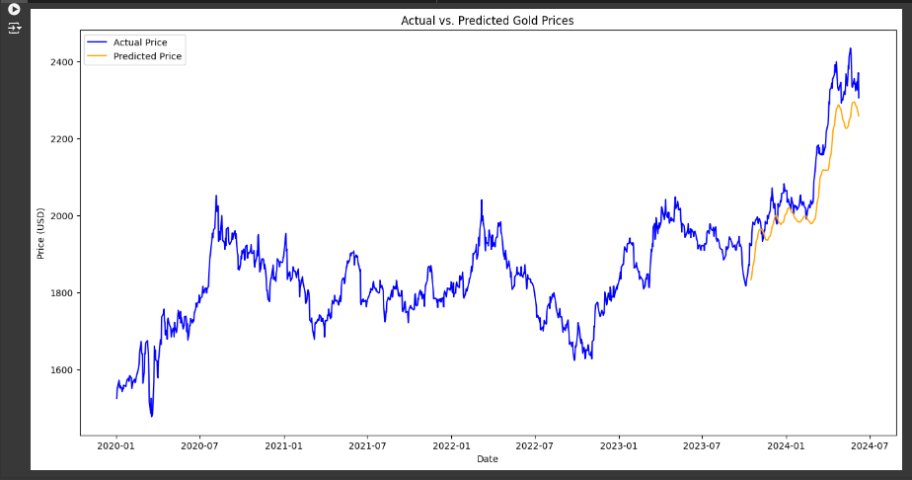
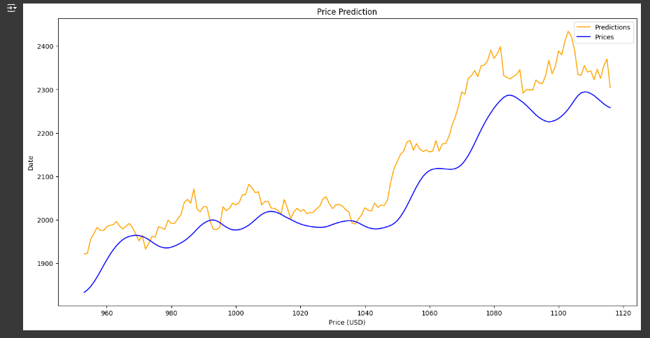
Model evaluation and prediction
The values were relatively high because
the dataset spanned a two-year period.
The visual results indicate a sharp decline in the coming months, followed by a significant rise. Such fluctuations could have a notable impact on the economies of gold-dependent countries.

Slide 3
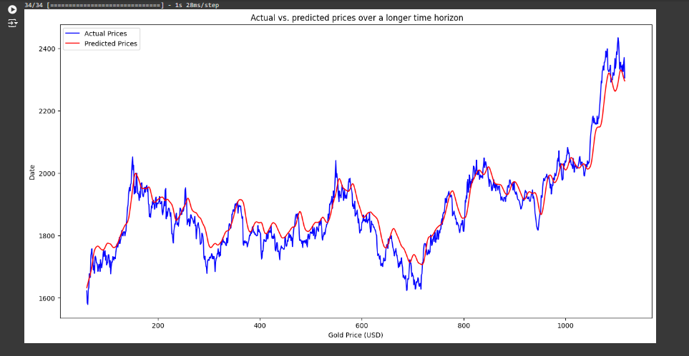
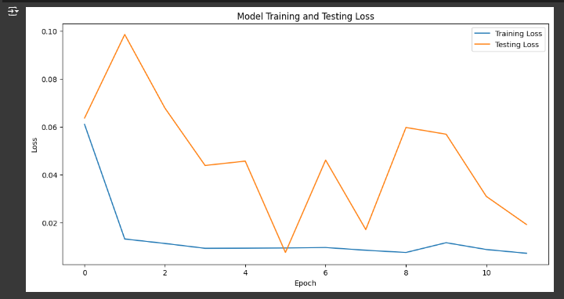
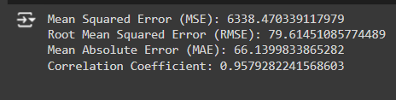
Enhancing visualization and analysis:
Plot actual versus predicted
prices over time.
Plot loss ratios for both
training and testing datasets.
Error ratios have
decreased noticeably.

Slide 4
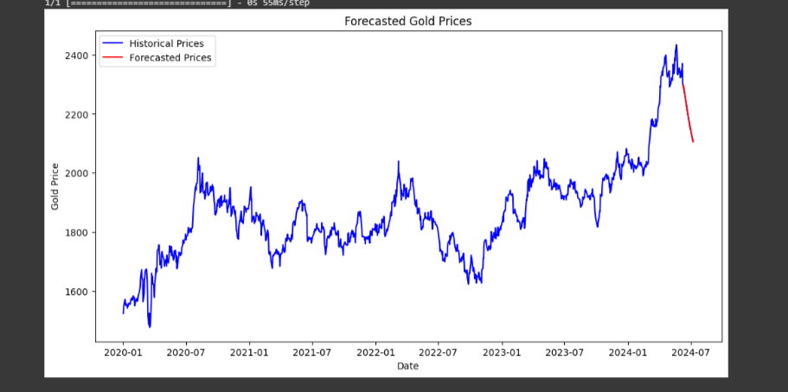
Future Price Predictions
We generated predictions starting from June 10. An additional 30 days were projected into the future. As shown in the graph, the price is expected to decline during this period.

Slide 5
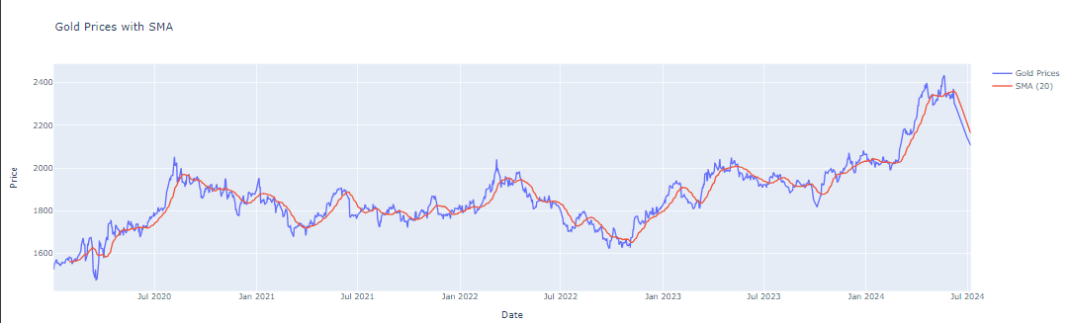
Creative Visualization

Slide 6
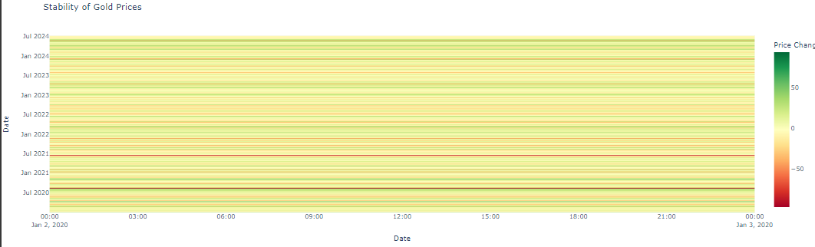
Creative Visualization

Slide 7
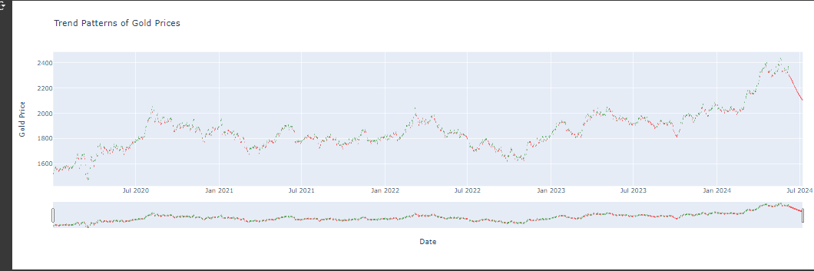
Creative Visualization

Slide 8
Analysis and Future Recommendations:
The model forecasts indicate that gold prices have reached a short-term peak.
Over the next 30 days, the price is expected to decline. This suggests that the market is likely entering a short-term correction phase.
Recommended Future Actions
Short-Term Strategy:
Avoid purchasing at the current peak price level due to increased risk of short-term loss.
Monitor the market closely and wait for lower price levels to re-enter.
Mid-Term Strategy:
Track the market during the projected decline to identify more favorable entry points.
Re-train or update the predictive model on a weekly basis to maintain accurate forecasting as new data becomes available.
Note: The SMA(20) indicator shown in the second chart confirms the same downside signal, indicating an early trend reversal. This acts as an additional confirmation of the anticipated short-term decline.

